Slide 1

Online quiz

Slide 2
Abstract
The “online Quiz” project will be developed to overcome the time consuming problem of manual system. Apart from that in currentsystem, checking the answer sheets after taking test, waste the examiners time, so this application will check the correct answer and save the examiner time and carry the examination in an effectivemanner. The users which are use this system don’t need to high computing knowledge and also system will inform them whileentering invalid data

Slide 3

Introduction
Develop By : Guided By:
Davda Nishit (206200316095) Mr.Jaydeep Tadhani Sir
Patadiya Parth (206200316084)
Chavda Meet (206200316065)
Department of Information Technology
Government Polytechnic, Rajkot
(Affiliated to Gujarat Technological University)

Slide 4
Online quiz is source to improve our knowledge we can learn general knowledge, sports, politics and some different category and varius programming language like PHP, JAVA, C++ etc.
INTRODUCTION
Advantages:
We can save the paper.
We can attend quiz any time any where any place.
We can increase knowledge.
We can save time.

Slide 5
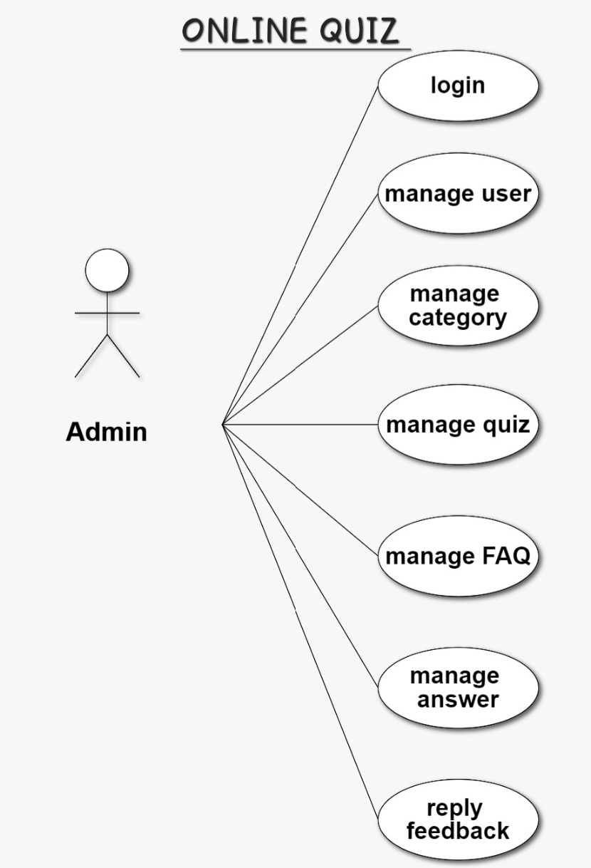
USE CASE DIAGRAM OF ADMIN

Slide 6
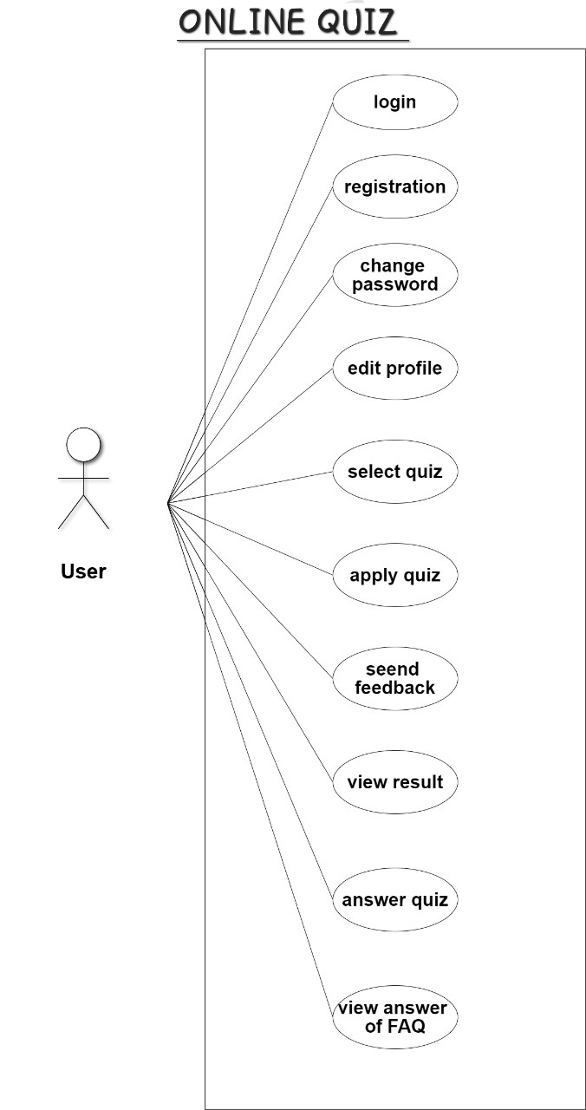
USE CASE DIAGRAM OF USER

Slide 7
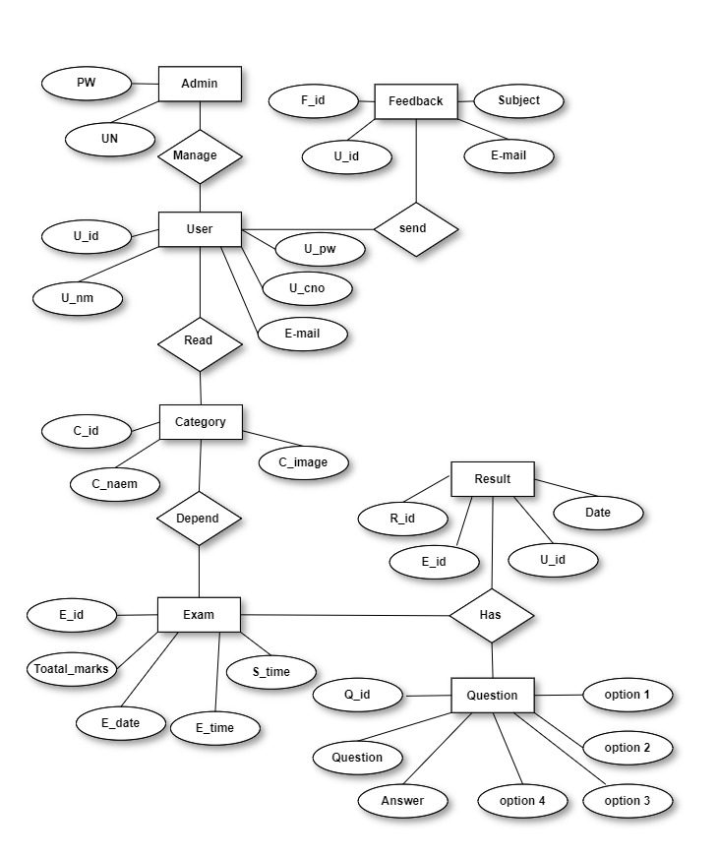
ER Diagram

Slide 8
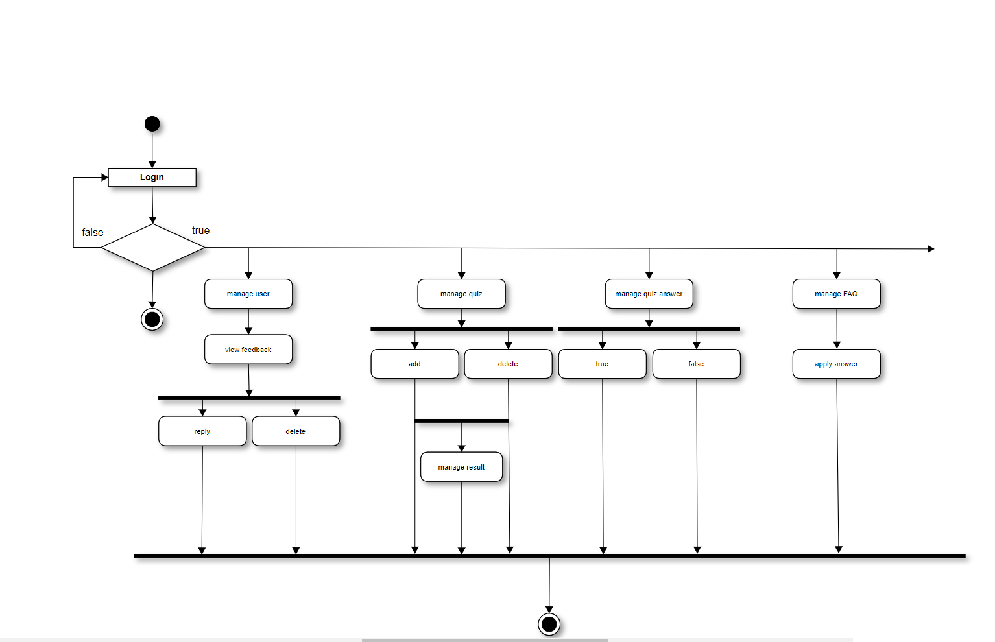
Activity Diagram OF ADMIN

Slide 9
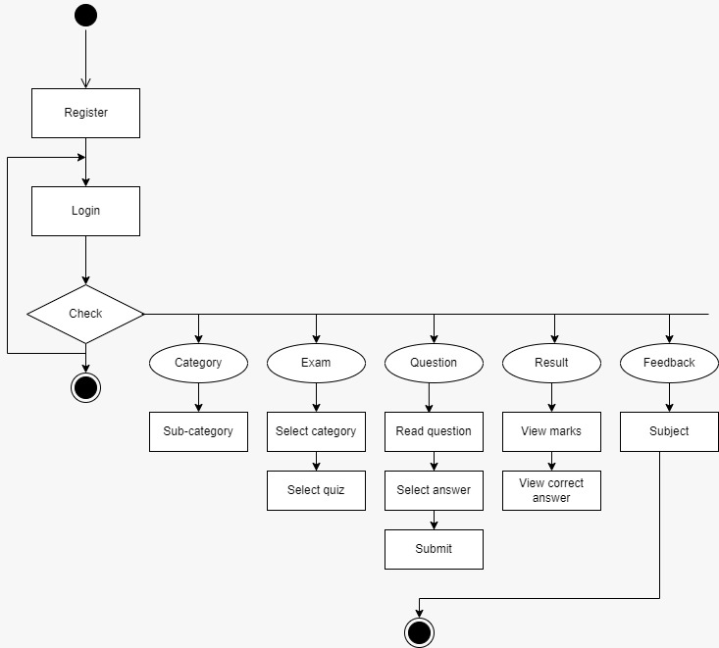
Activity Diagram OF USER

Slide 10
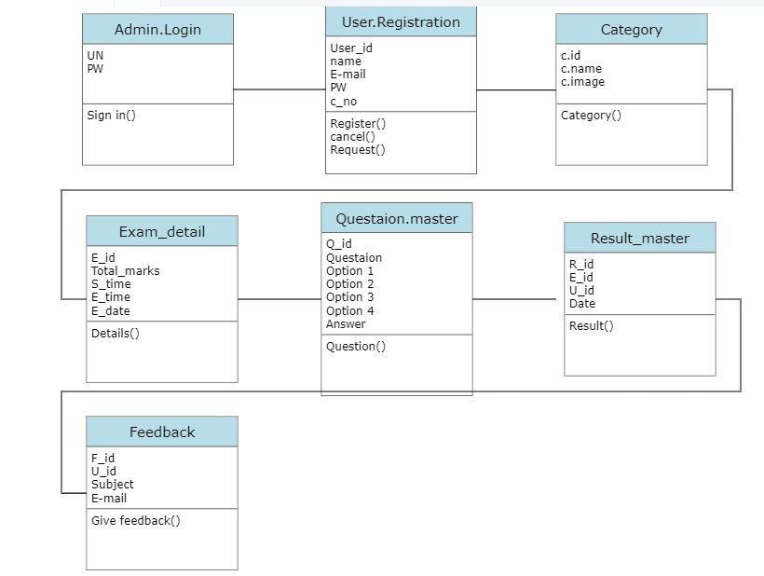
CLASS DIAGRAM

Slide 11
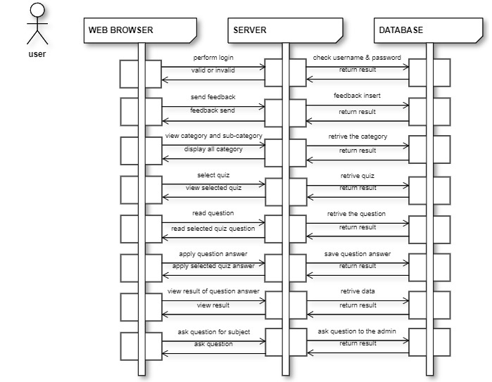
Sequence DIAGRAM

Slide 12
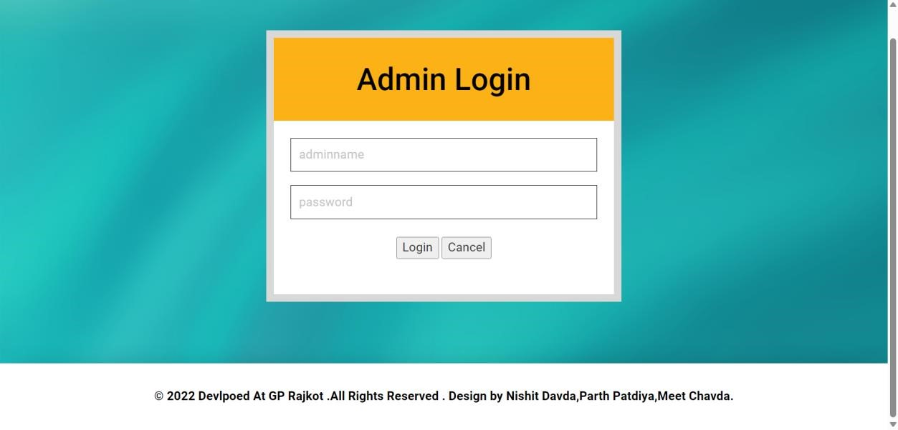
Admin Login

Slide 13
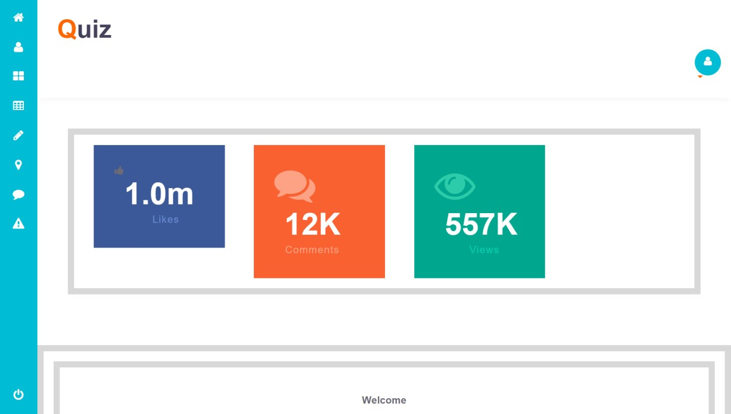
Admin Dashboard Page

Slide 14
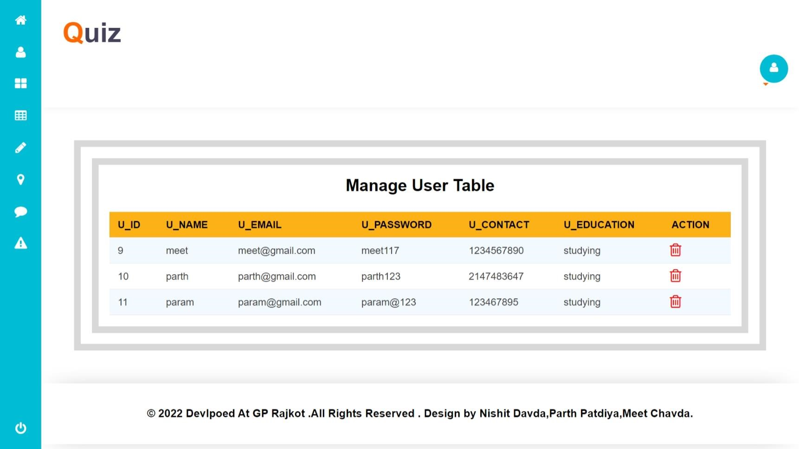
Admin User Managment Page :

Slide 15
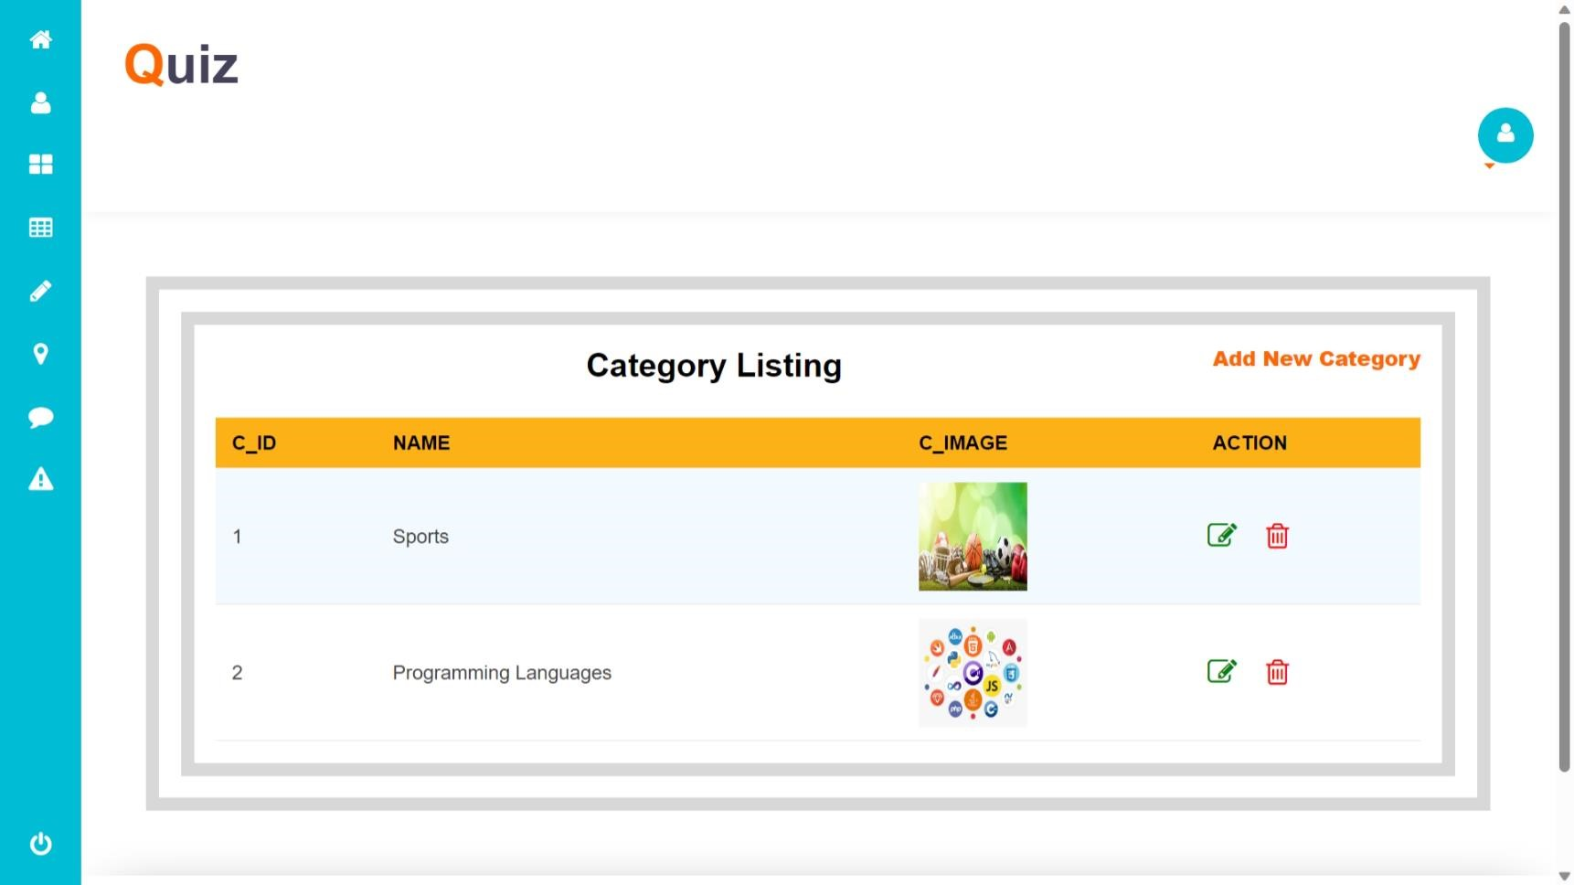
Admin View Category Page:

Slide 16
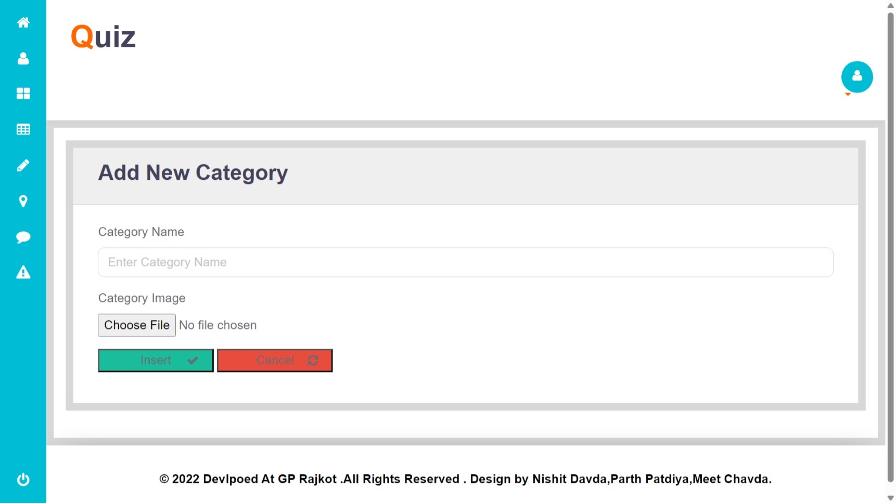
Admin Add Category Page:

Slide 17
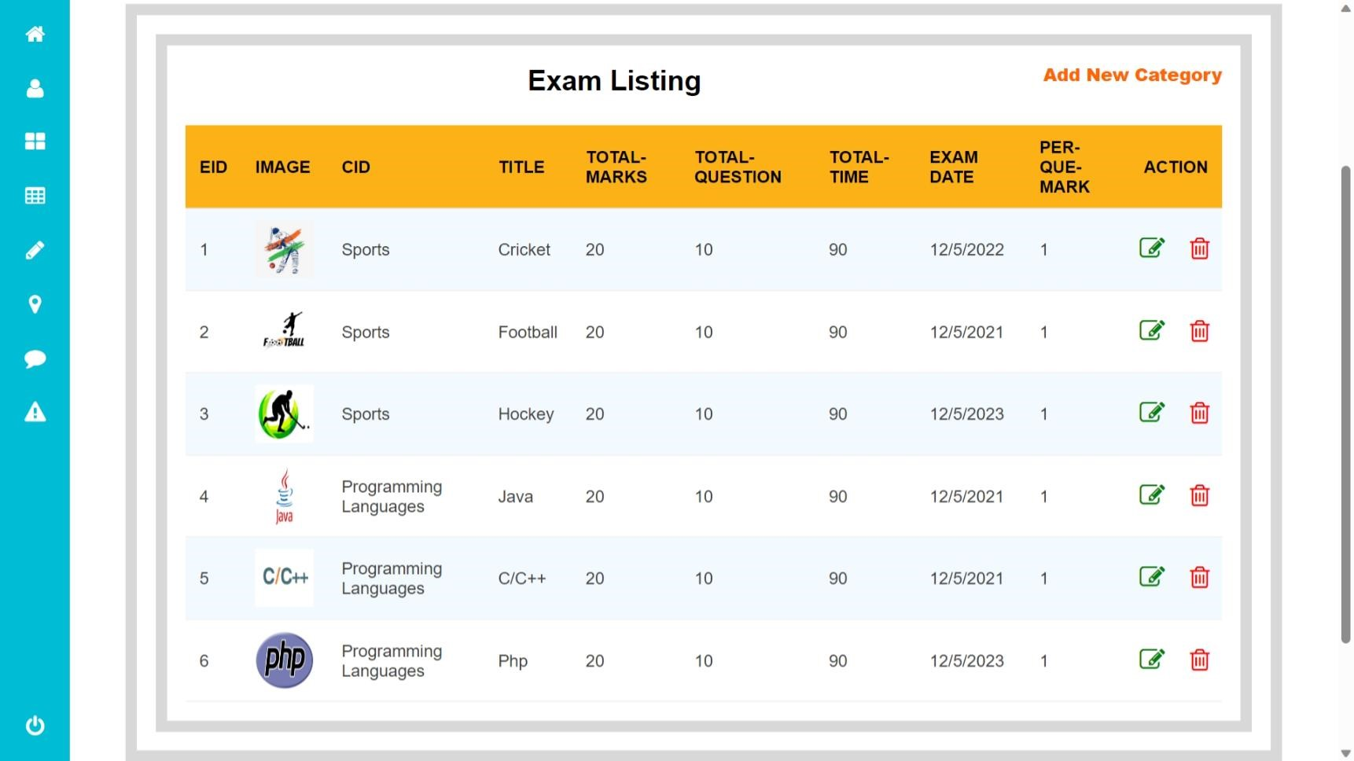
Admin Exam Detail Page:

Slide 18
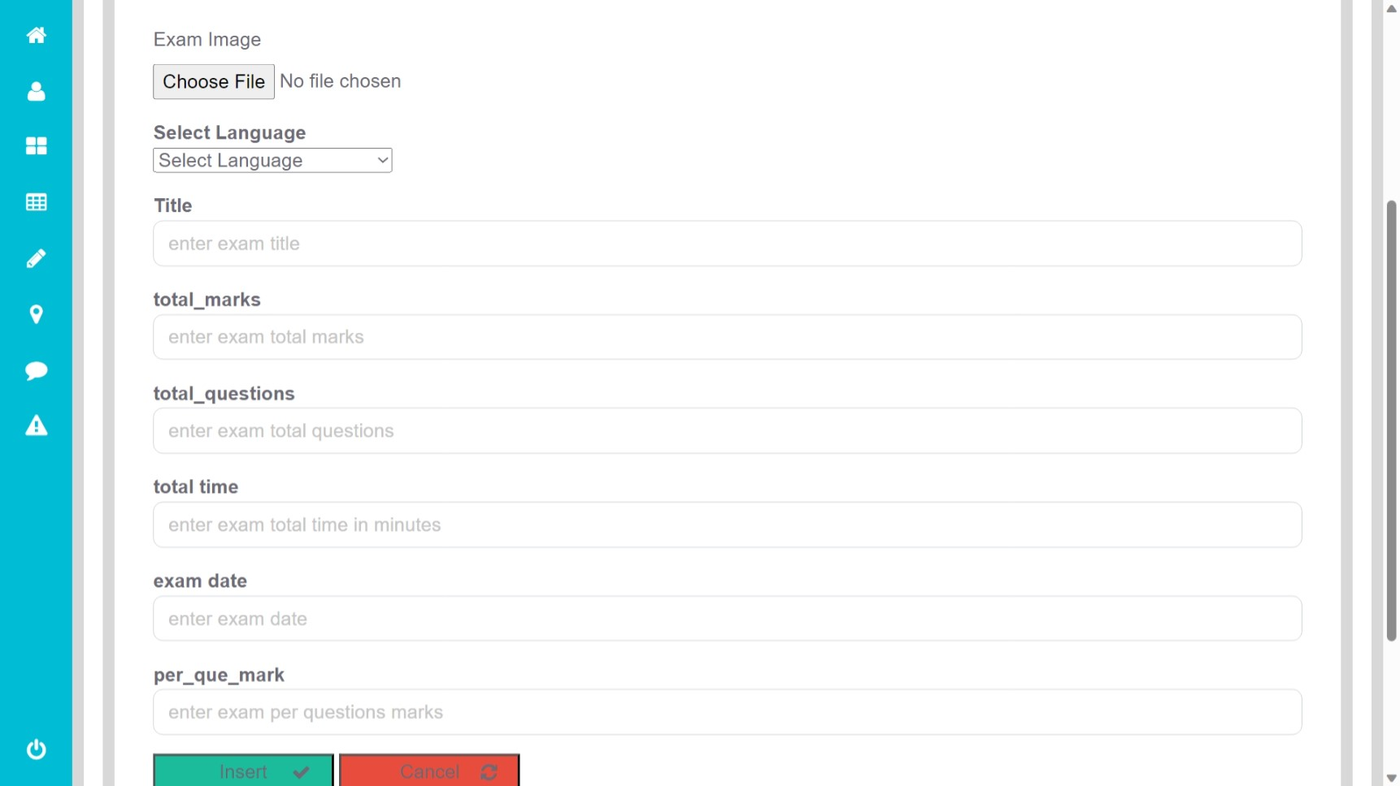
Admin Add New EXAM Page :

Slide 19
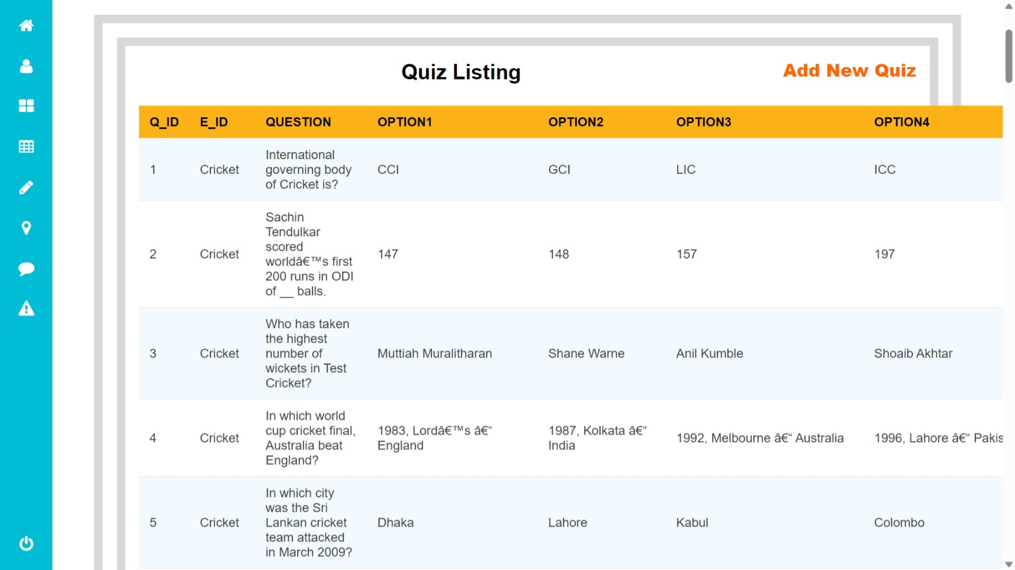
Admin View Quiz Page :

Slide 20
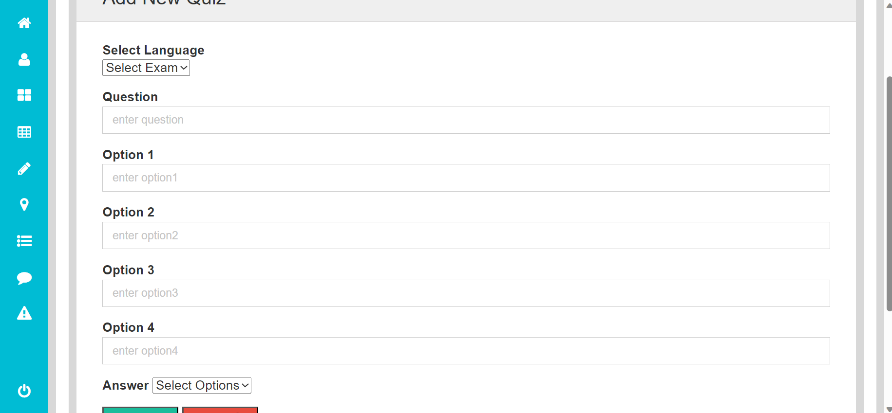
Admin Add New Quiz Page :

Slide 21
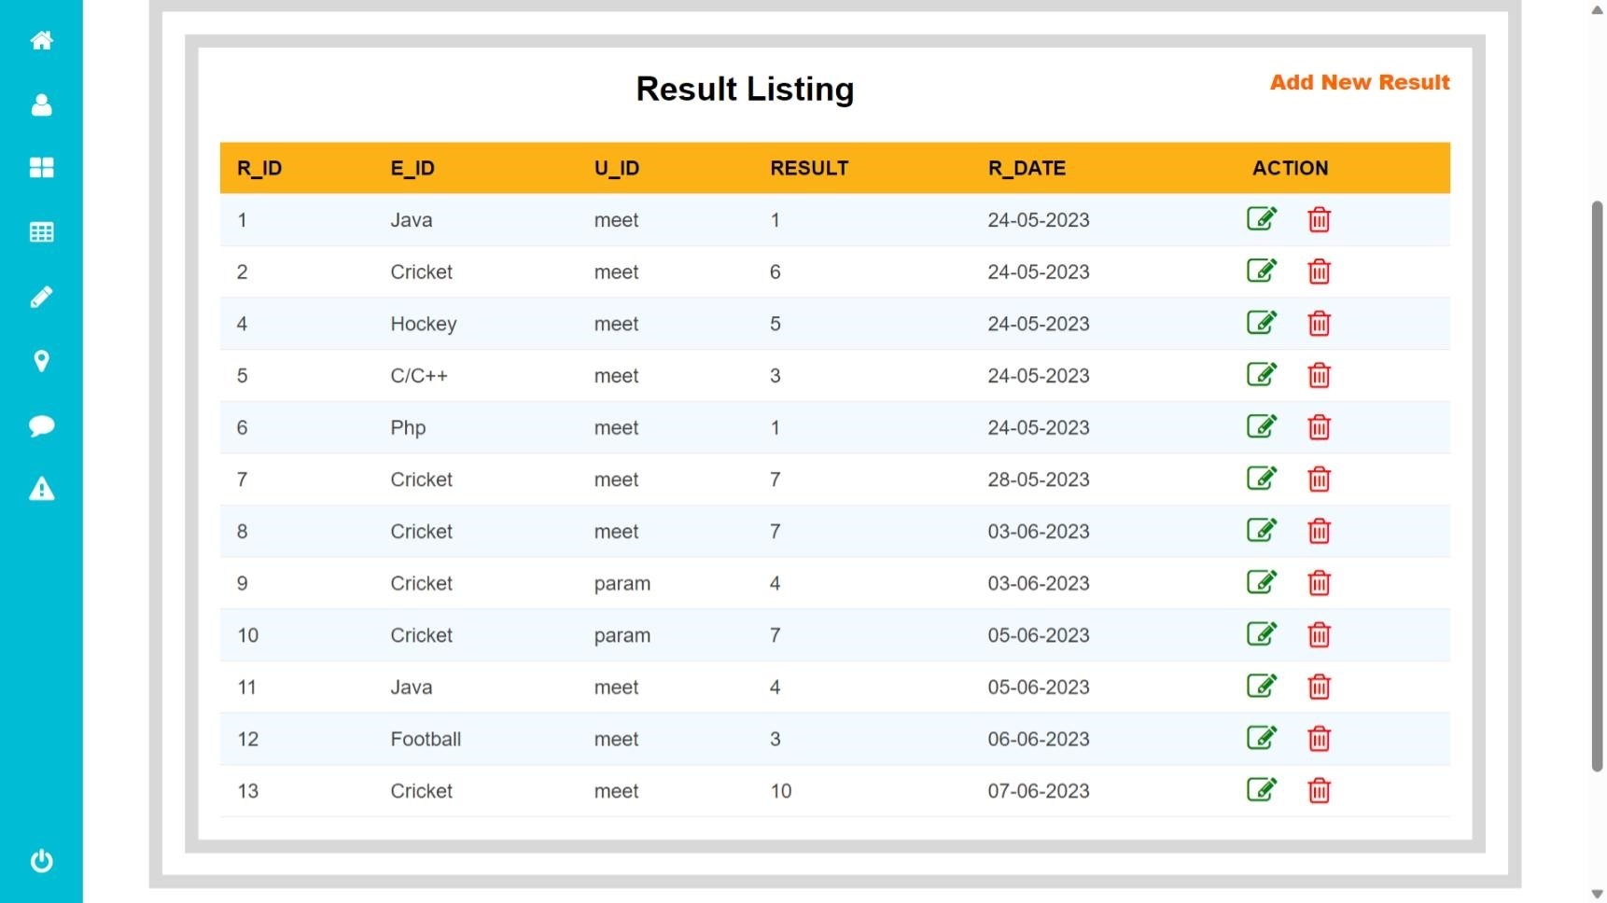
Admin Result Page :

Slide 22
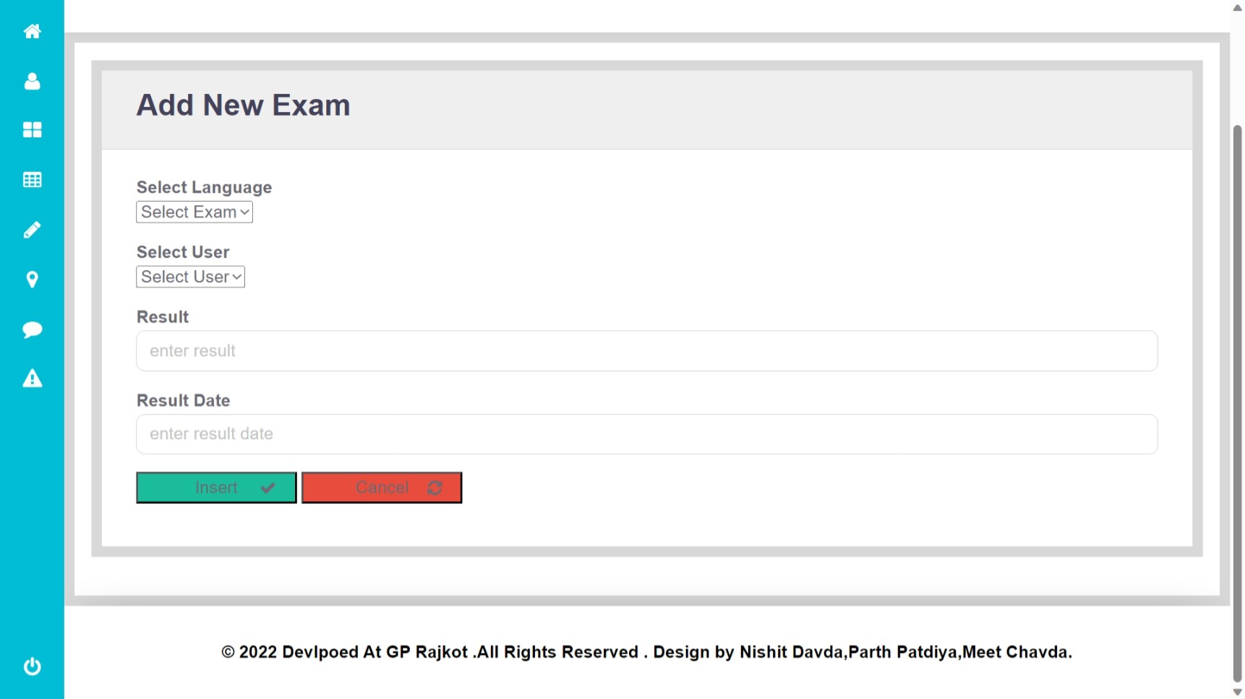
Admin Add New Result Page :

Slide 23
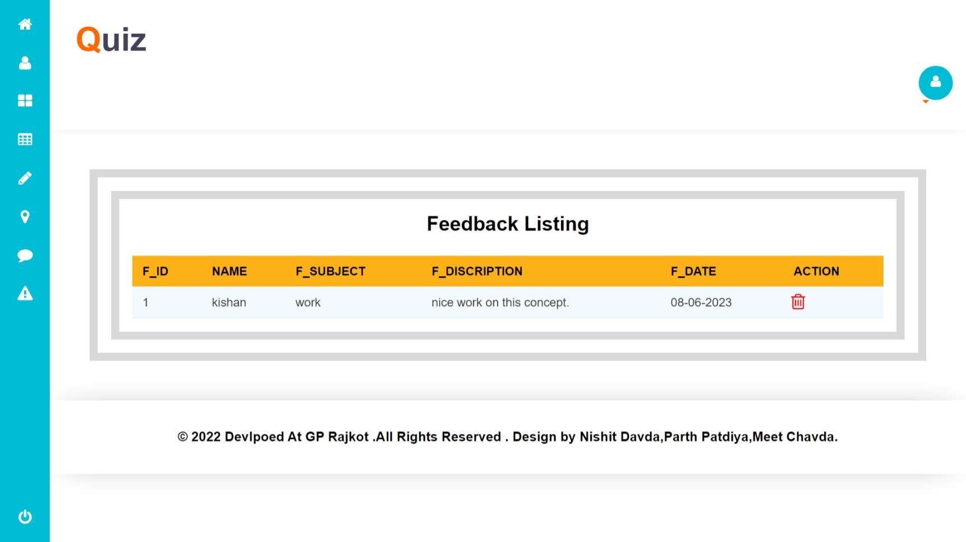
Admin Feedback Page :

Slide 24
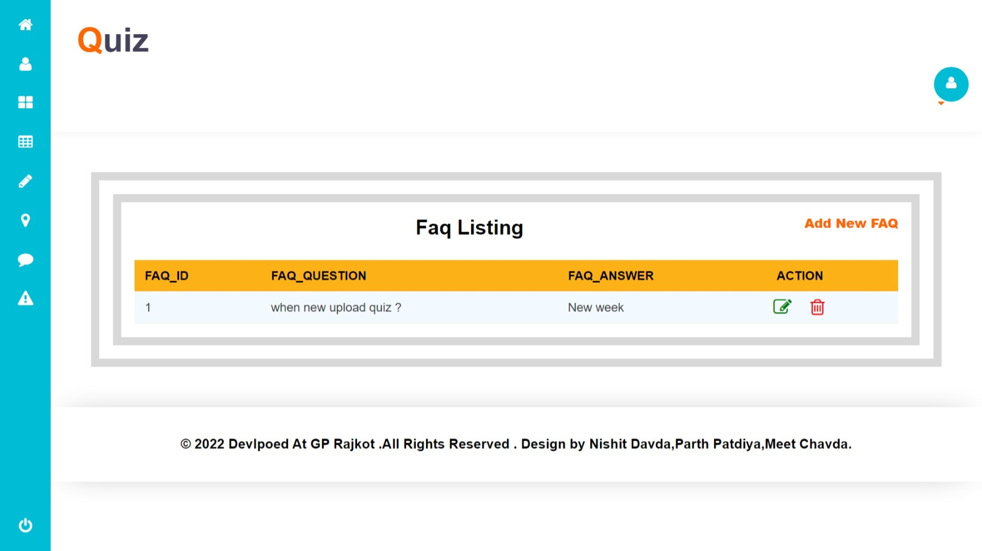
Admin FAQ Page :

Slide 25
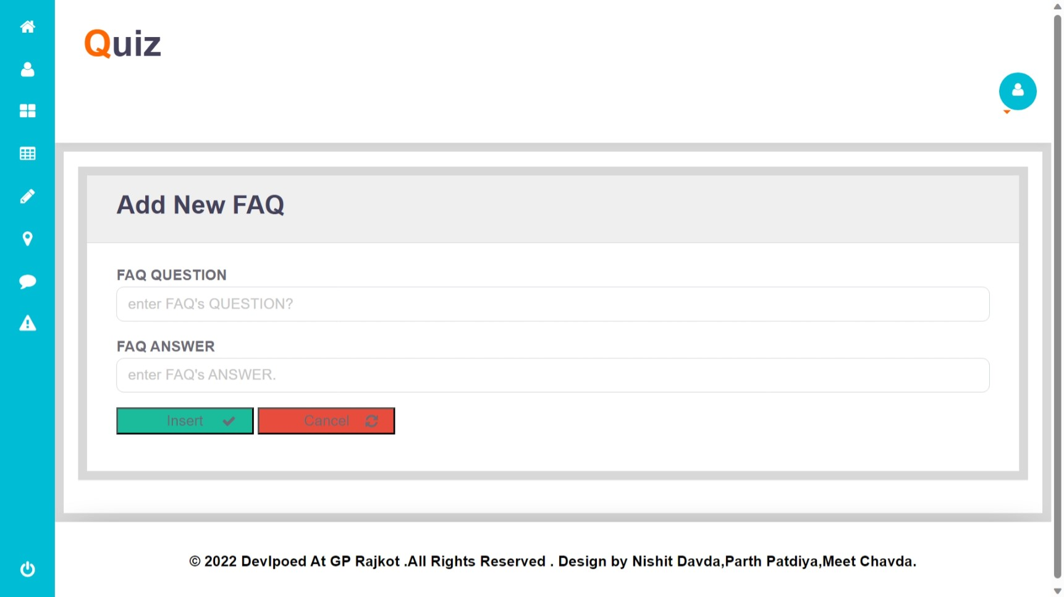
Admin Add New FAQ Page :

Slide 26
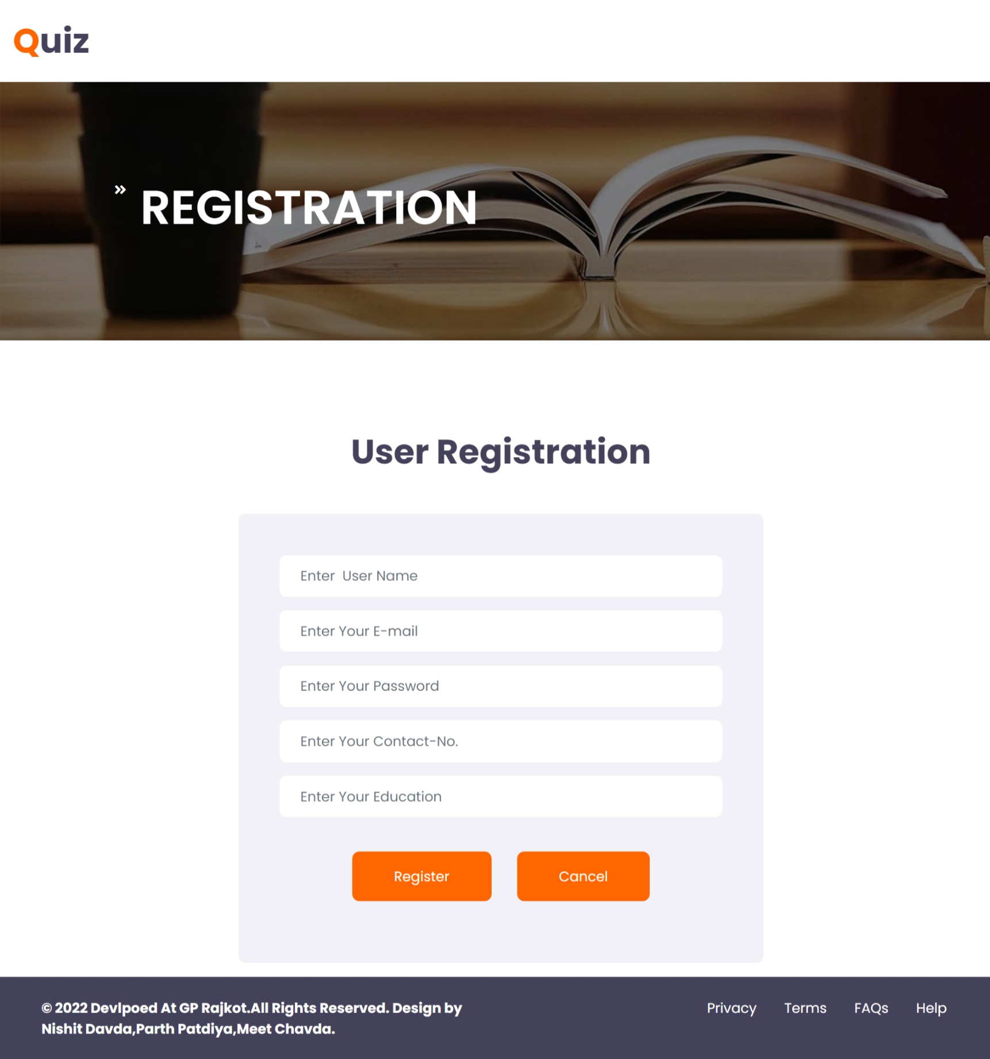
User rEGISTRATION Page :

Slide 27
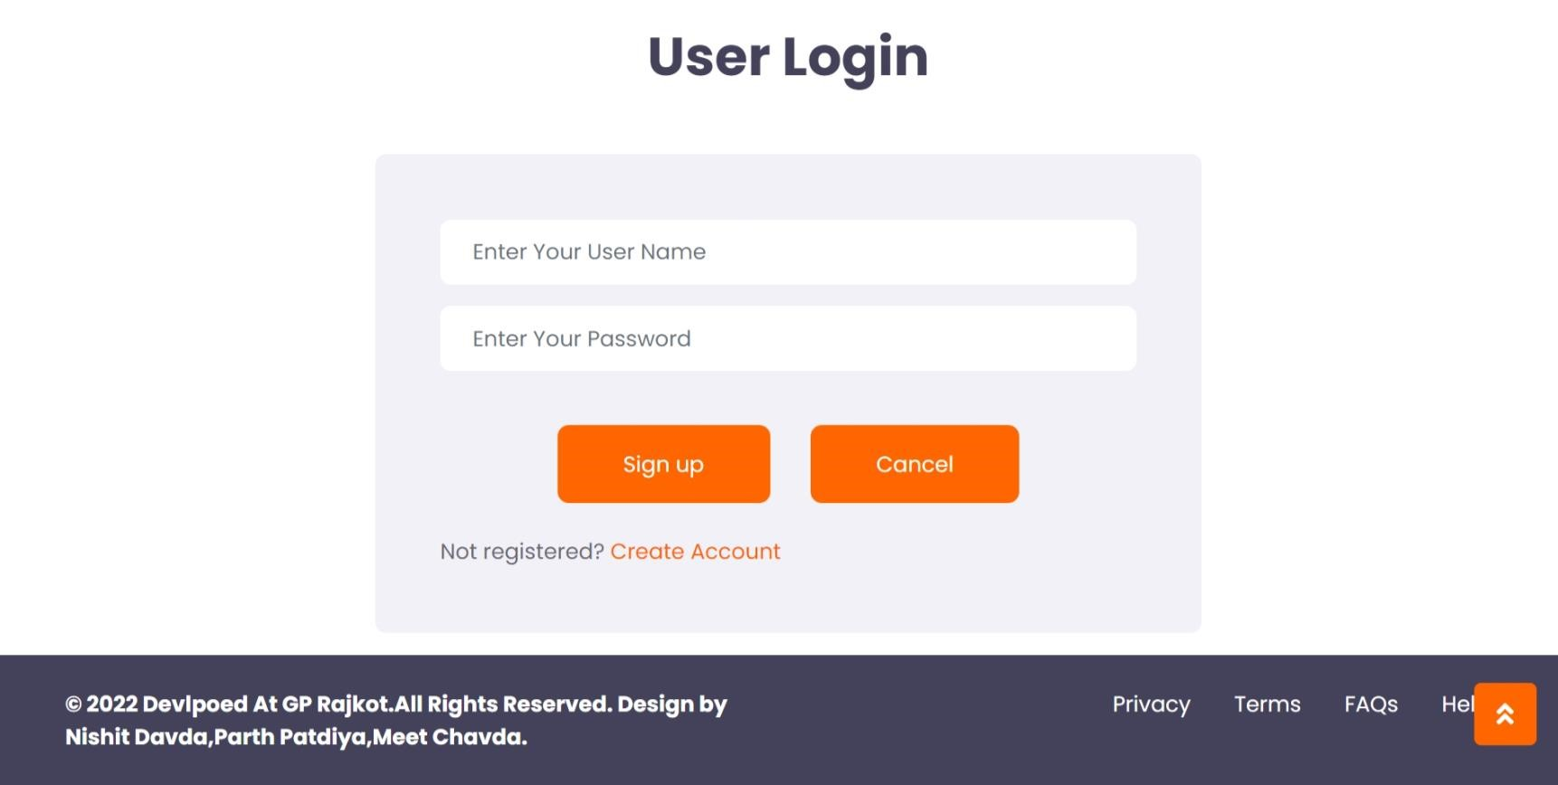
User Login Page :

Slide 28

User Home Page :

Slide 29
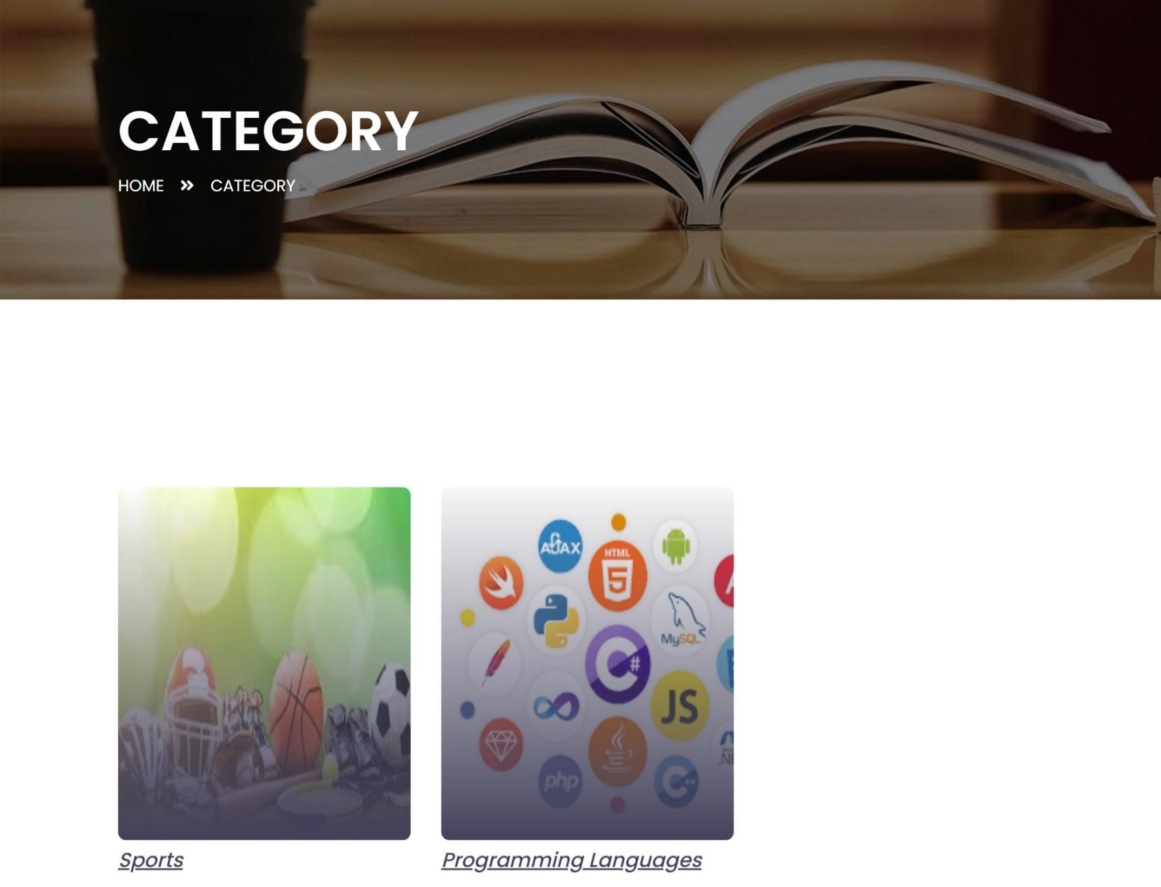
User Caregory Page :

Slide 30
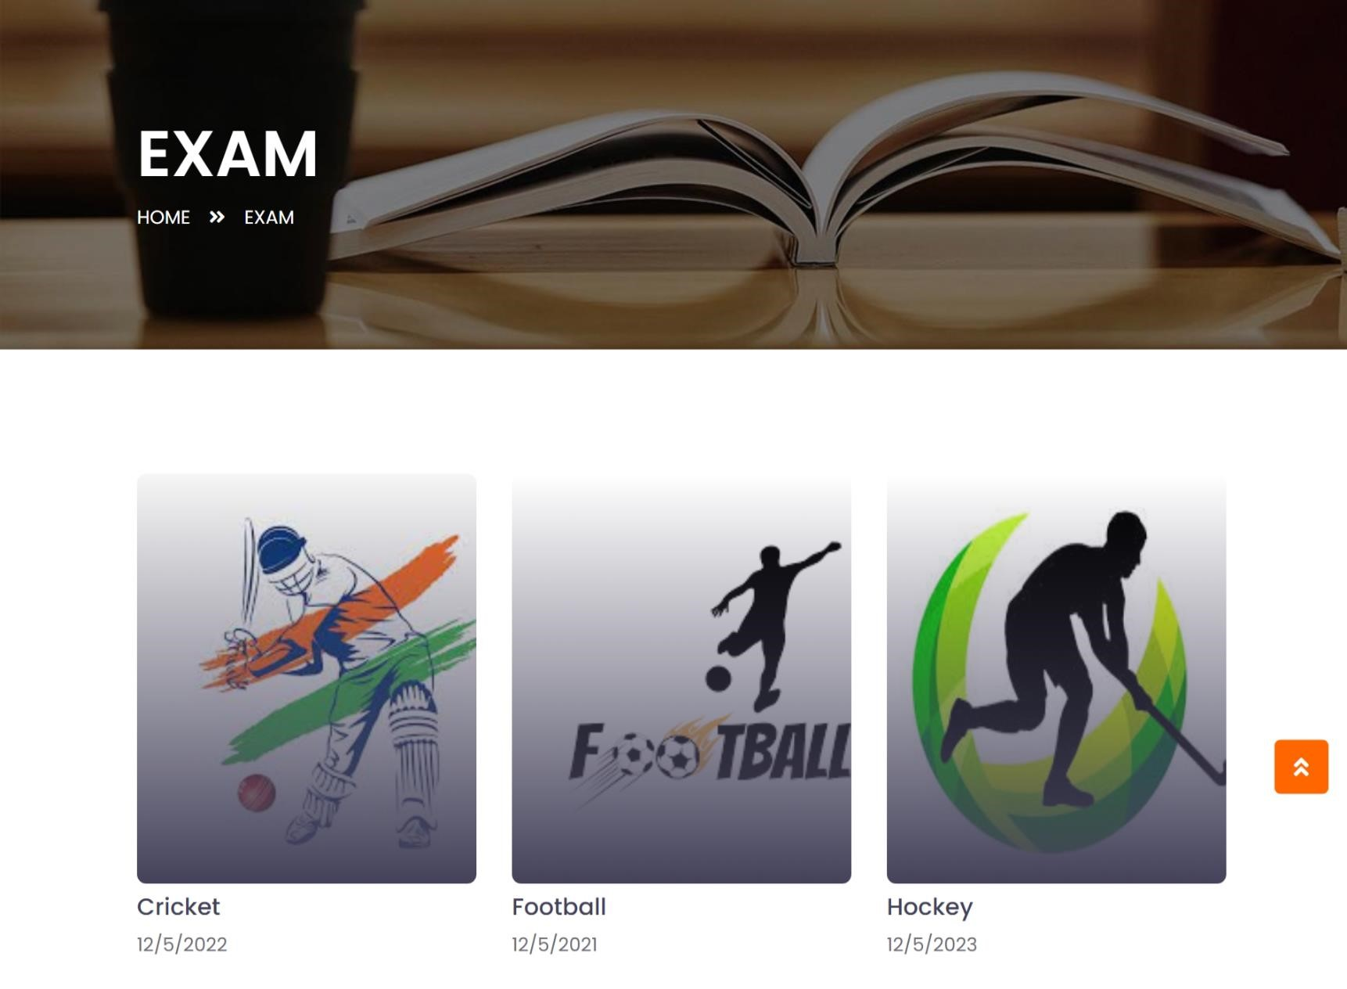
User Exam Selection Page :

Slide 31
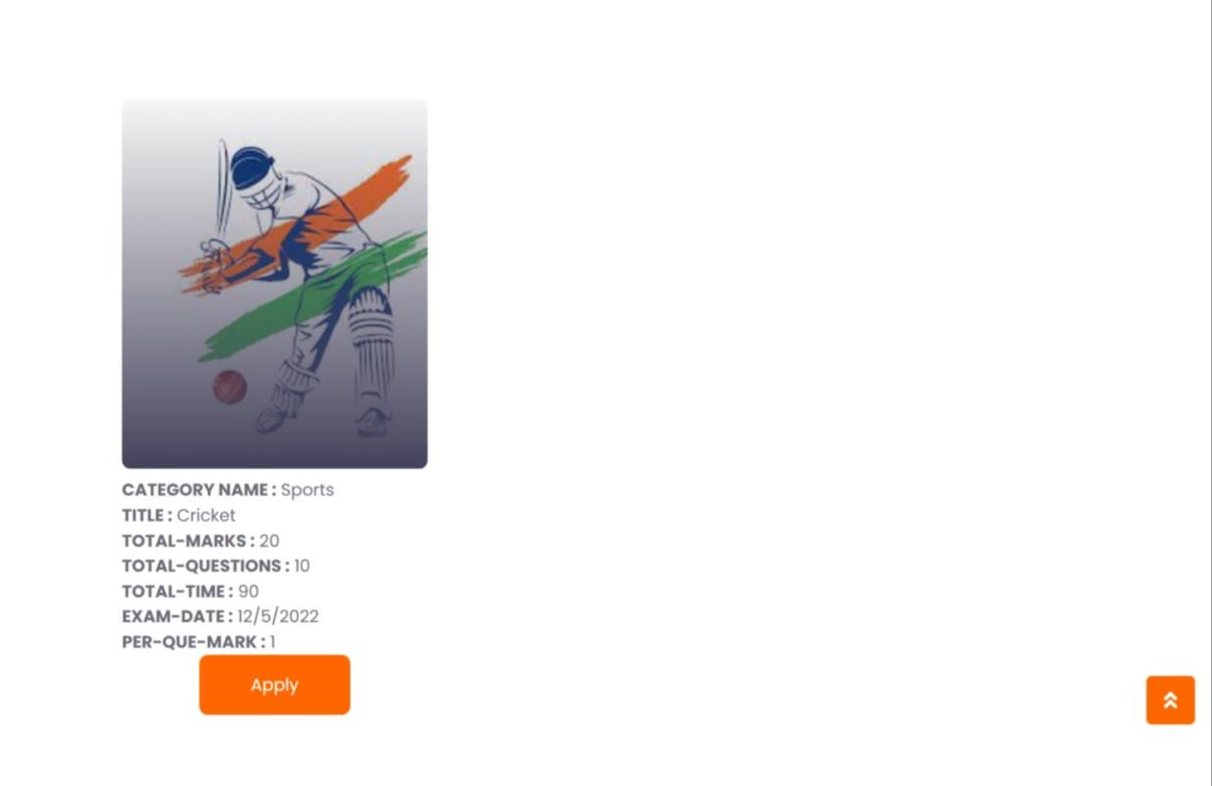
User Exam Detail Page :

Slide 32
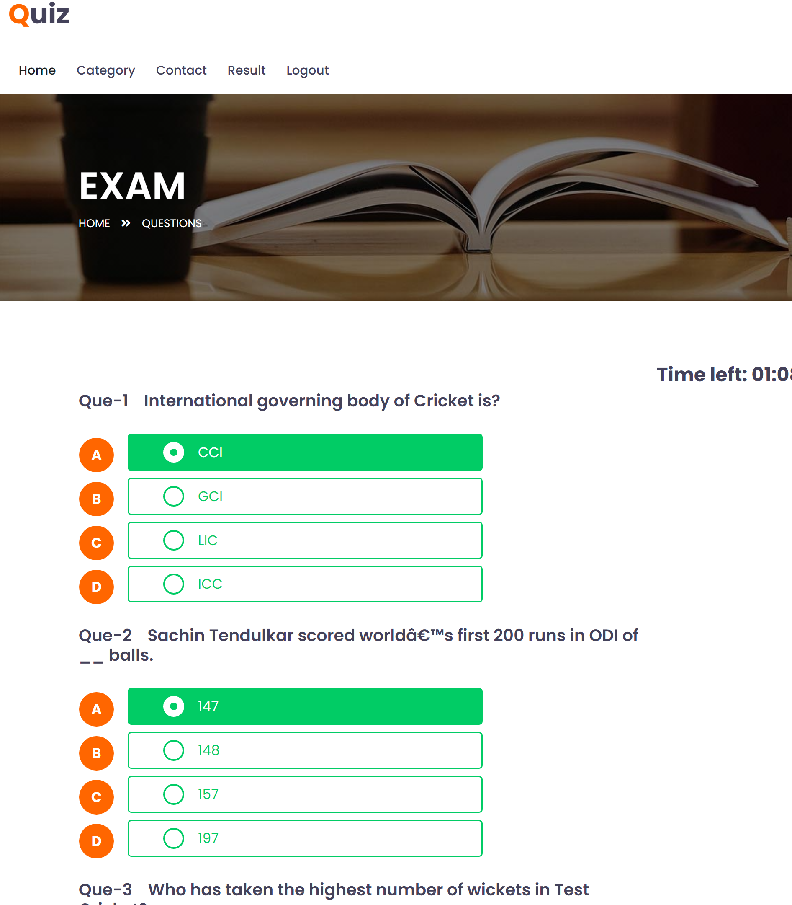
User EXAM Page :

Slide 33
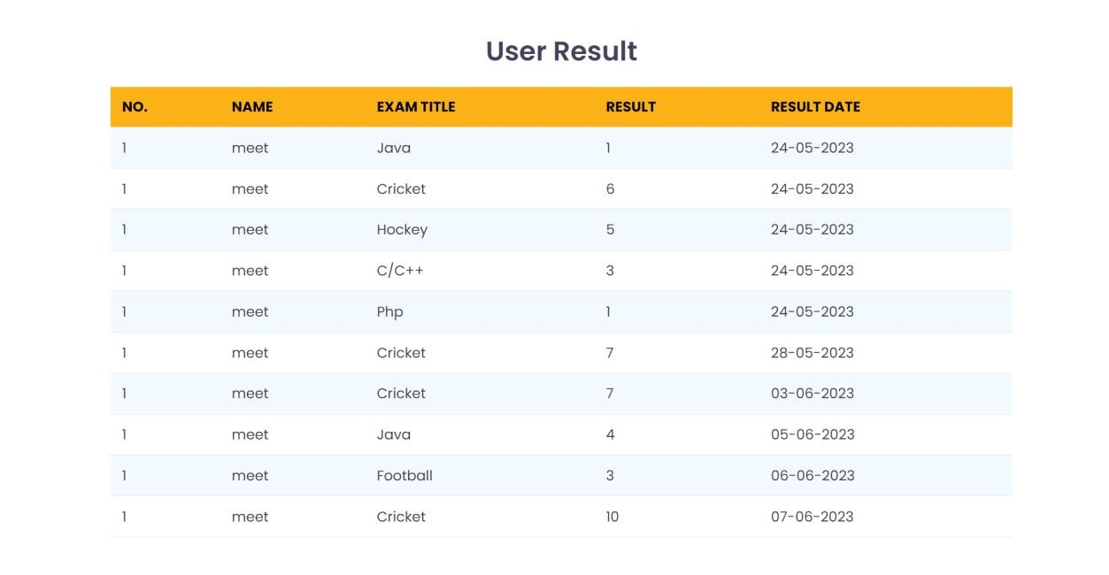
User Result Page :

Slide 34
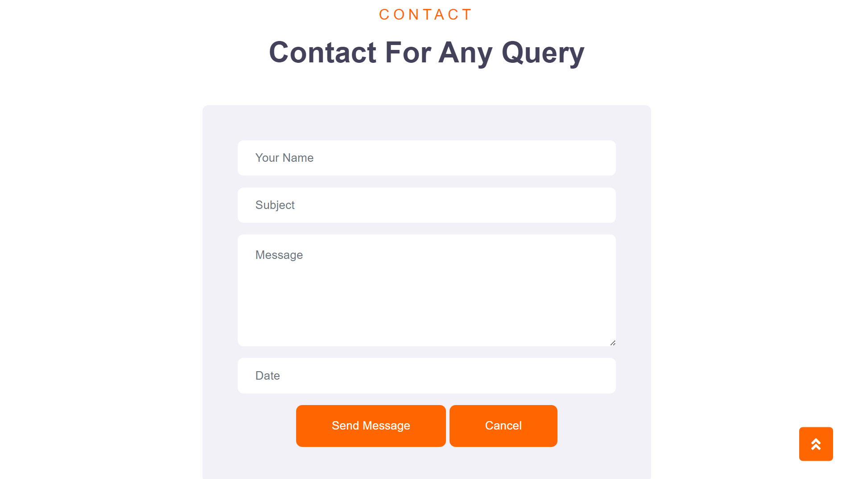
User Contact Page :

Slide 35
Limitation Of Our System
Challenges in Technology AdoptionInfrastructural Barriers
Difficulty in Grading Long-answer TypeSusceptible to Cheating
Transitioning to Open-Book Exams
Susceptible to Malpractices like Cheating & Plagiarism
Internet Dependency
Requires Technical Equipment

Slide 36
FUTURE SCOPE OF OUR SYSTEM
Online Examination System is widely used as compared to other exams.
Online examination system can be used in private institutes as well as educational institution.
As it is user friendly web base application it can be used anywhere and anytime.

Slide 37
References
https://www.w3schools.com
https://cacoo.com
libraryhub.com
https://www.w3schools.com
https://www.tutorialspoint.com

